Slide 1
Pruning Strategies and Their Role in Transfer Learning Aakash Agarwal, Saaransh Pandey
12/04/2024

Slide 2
Problem & Motivation
Compare and evaluate different pruning techniques
Preserving model performance while achieving high sparsity.
Addressing trade-offs between computational efficiency and accuracy.
Optimize large models like VGG16 for deployment in resource constrained environments
Enable efficient Transfer Learning by retraining pruned models on new tasks

Slide 3
Contents:
Problem & Motivation
Model
Details of the Contributions
Global Weight Pruning
Layer-wise Weight Pruning
Layer Channel Pruning
Iterative Pruning
Extending to Transfer Learning
Conclusions

Slide 4
Model
Pruning techniques implemented:
Global Pruning
Layer-wise Pruning
Layer-wise Channel Pruning
Hardened Pruning
Iterative Pruning
Extension to Transfer Learning
Enable efficient use of pruned models in real-world applications

Slide 5
Global Weight Pruning
A model compression technique that removes the least important weights across all layers, determined by a specific criterion (e.g., L1 norm)
Identify (global) unimportant weights
Compute the L1 norm of all weights and rank them globally, irrespective of their layer
Prune Weights
Experimental Setup:
Dataset: Imagenet validation dataset
Model (Baseline): Pretrained VGG16
Pruning Method: L1 Norm-Based Pruning
Prune Amounts: From 5% to 45% (increments of 5%)
Eval Metric: Top-1 Accuracy

Slide 6
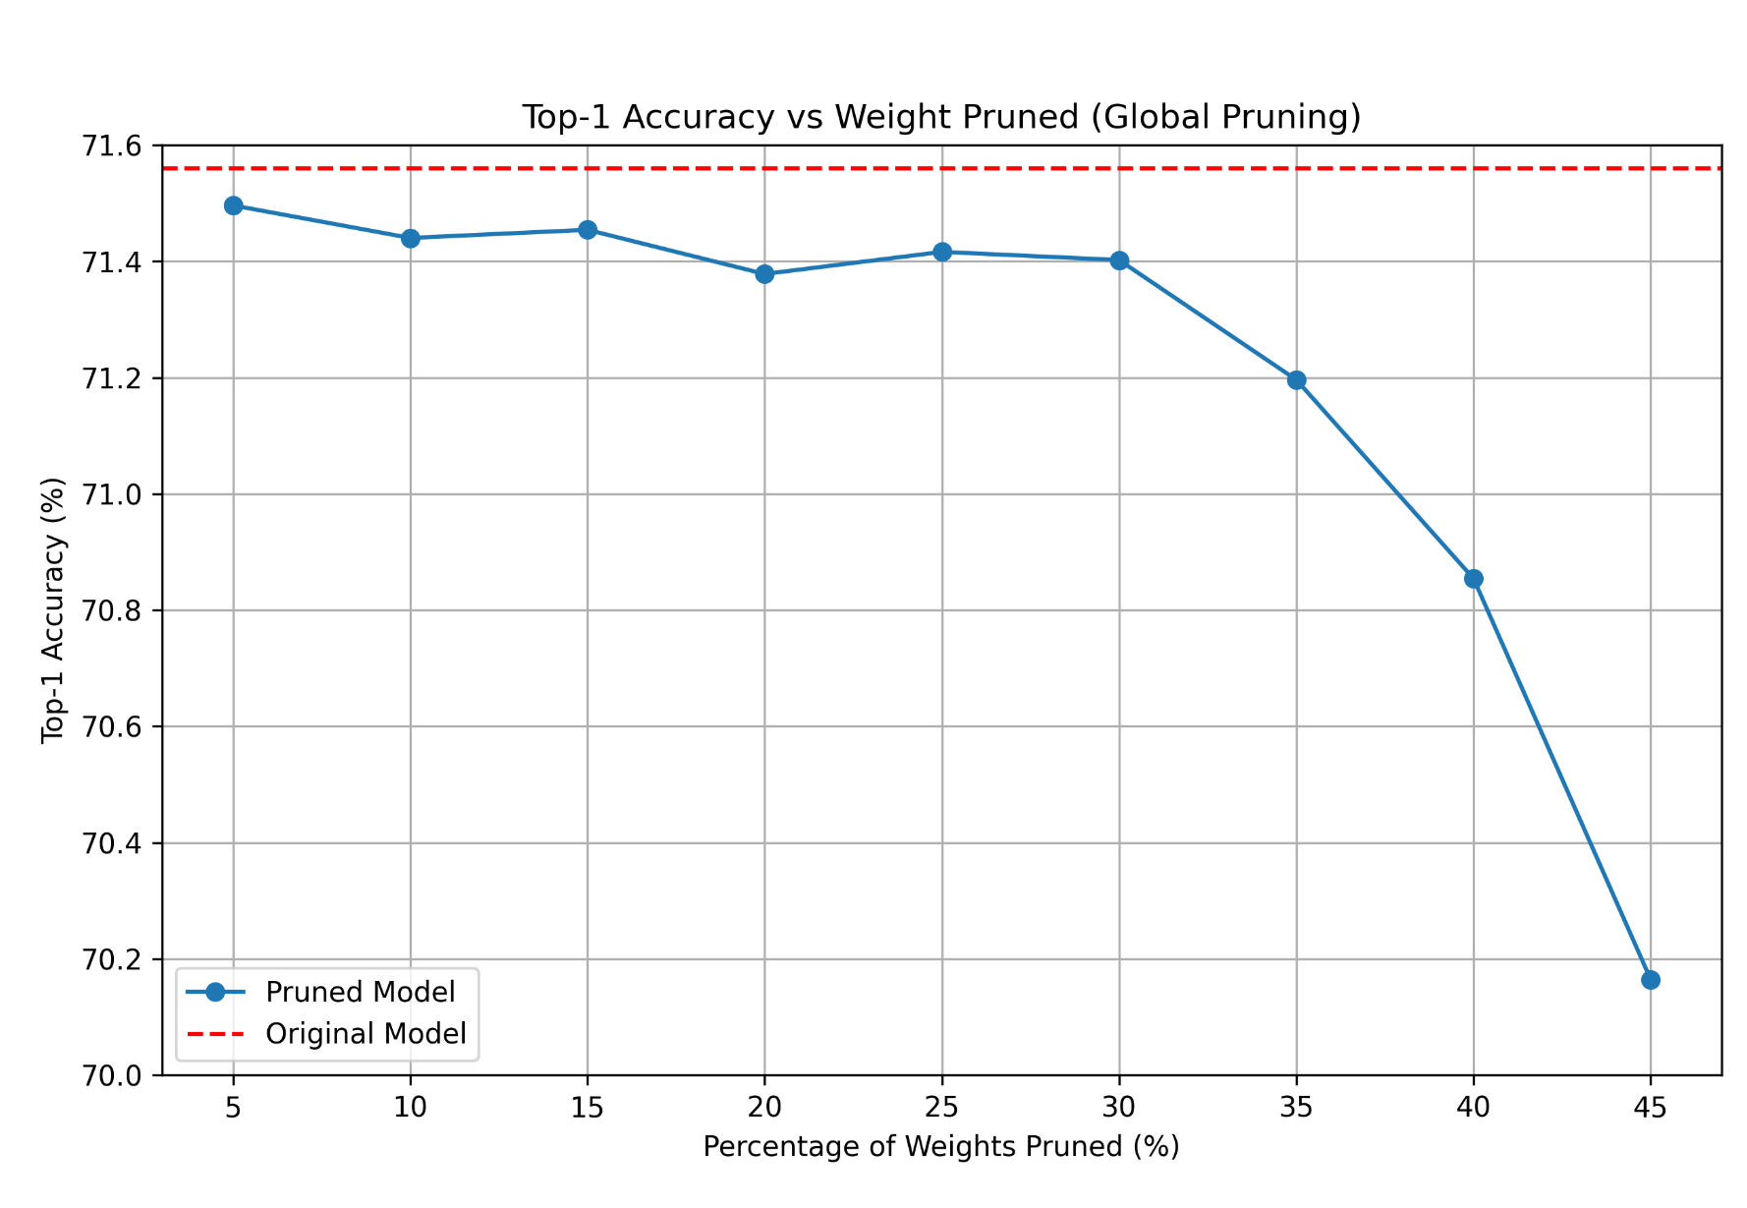
Global Weight Pruning (Results)
The top-1 accuracy remains close to the original VGG16 model's accuracy upto 30% pruning
Beyond 35% pruning, although the accuracy drops noticeably, with a decline at 40% and 45%, it still maintains a relatively high accuracy around 70% at 45% pruning.
Baseline Model Validation Accuracy: 71.56%
Fig. 1: Plot for Top-1 Accuracy vs Weights Pruned via Global Weight Pruning Method
Notes:
This suggests that less significant weights are successfully removed without affecting model performance significantly.
This indicates that while some critical weights contributing to the model's performance are being pruned, the loss in accuracy remains moderate, demonstrating the model's resilience to pruning even at higher sparsity levels.
potential disadvantages – ??

Slide 7
2. Layer-wise Weight Pruning
A model compression technique that removes the least important weights within each layer independently, based on a specific criterion (e.g., L1 norm).
Identify (per layer) unimportant weights
Compute the L1 norm of weights and rank them within each layer
Prune Weights for each layer
Experimental Setup:
Dataset: Imagenet validation dataset
Model (Baseline): Pretrained VGG16
Pruning Method: L1 Norm-Based Pruning
Prune Amounts: From 5% to 45% (increments of 5%)
Eval Metric: Top-1 Accuracy
Notes:
Advantages
Fine-grained control over sparsity in each layer.
Retains critical features in sensitive layers, especially at lower pruning percentages.
Challenges
Performance degradation at higher sparsity levels (>35%), as layer-specific pruning may fail to preserve globally significant weights.

Slide 8
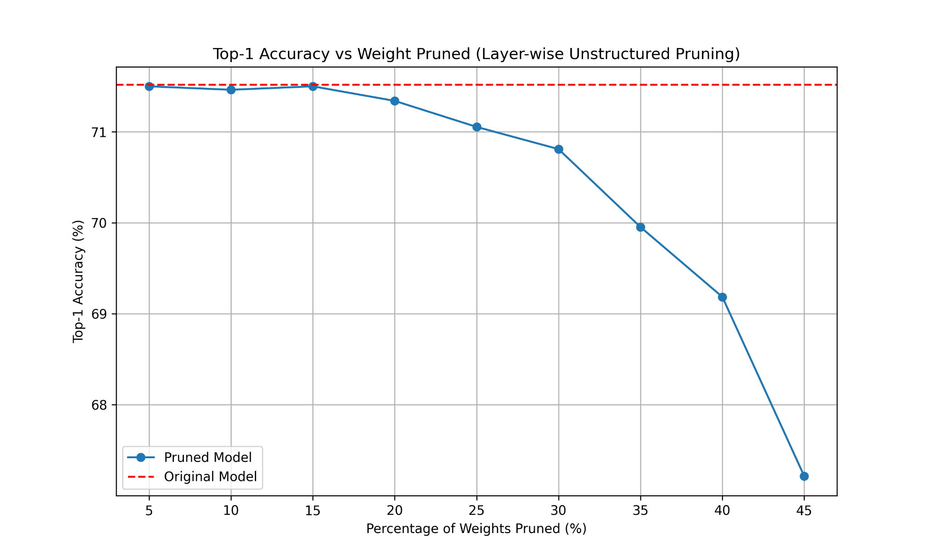
2. Layer-wise Weight Pruning (Results)
The top-1 accuracy remains close to the original VGG16 model's accuracy upto 15% pruning.
From 20% to 30% pruning, the accuracy begins to drop steadily.
Beyond 30% pruning, the accuracy decline becomes more pronounced, with the top-1 accuracy dropping at 45% to around 67%.
Baseline Model Validation Accuracy: 71.56%
Fig. 2: Plot for Top-1 Accuracy vs Weights Pruned via Layer-wise Weight Pruning Method

Slide 9
3. Layer-wise Channel Pruning
A model compression technique that removes entire output channels (feature maps) or output dimensions independently for each layer, based on their L1 norm.
Compute the L1 norm for all output channels in a layer.
Rank channels by importance and mask (set to zero) the least important ones.
The model’s structure is not altered, and pruned channels remain physically present in memory.
Experimental Setup:
Dataset: Imagenet validation dataset
Model (Baseline): Pretrained VGG16
Pruning Method: L1 Norm-Based Layer-Wise Channel Pruning
Prune Amounts: From 5% to 45% (increments of 5%)
Eval Metric: Top-1 Accuracy

Slide 10
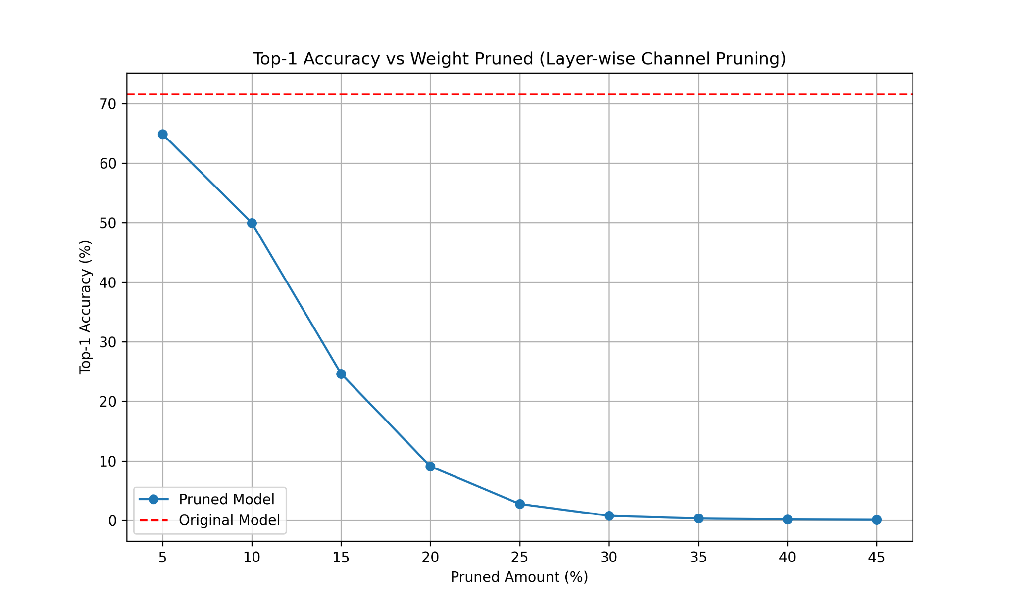
3. Layer-wise Channel Pruning (Results)
The relative top-1 accuracy drops sharply even at low pruning percentages 5%-10% compared to the original model.
Beyond 10% pruning, the accuracy declines drastically, and the model loses most of its predictive capacity by 25%, with negligible accuracy at higher pruning levels 30%-45%.
Baseline Model Validation Accuracy: 71.56%
Fig. 3: Plots for Top-1 Accuracy vs Weights Pruned via Layer-wise Channel Pruning Method

Slide 11
3.5 Layer-wise Channel (Hardened) Pruning
A model compression technique that extends layer-wise channel pruning by permanently removing pruned channels and updating the model architecture.
Collect the number of non-zero channels in each layer after pruning.
Instantiate a new model with reduced dimensions matching the non-zero channels.
Copy the non-zero weights into the new architecture, ensuring layer compatibility.
Experimental Setup:
Dataset: Imagenet validation dataset
Model (Baseline): Pretrained VGG16
Pruning Method: Hardened Layer-Wise Channel Pruning.
Prune Amounts: From 5% to 45% (increments of 5%)
Eval Metric: Top-1 Accuracy, Model Runtime, Model Size

Slide 12
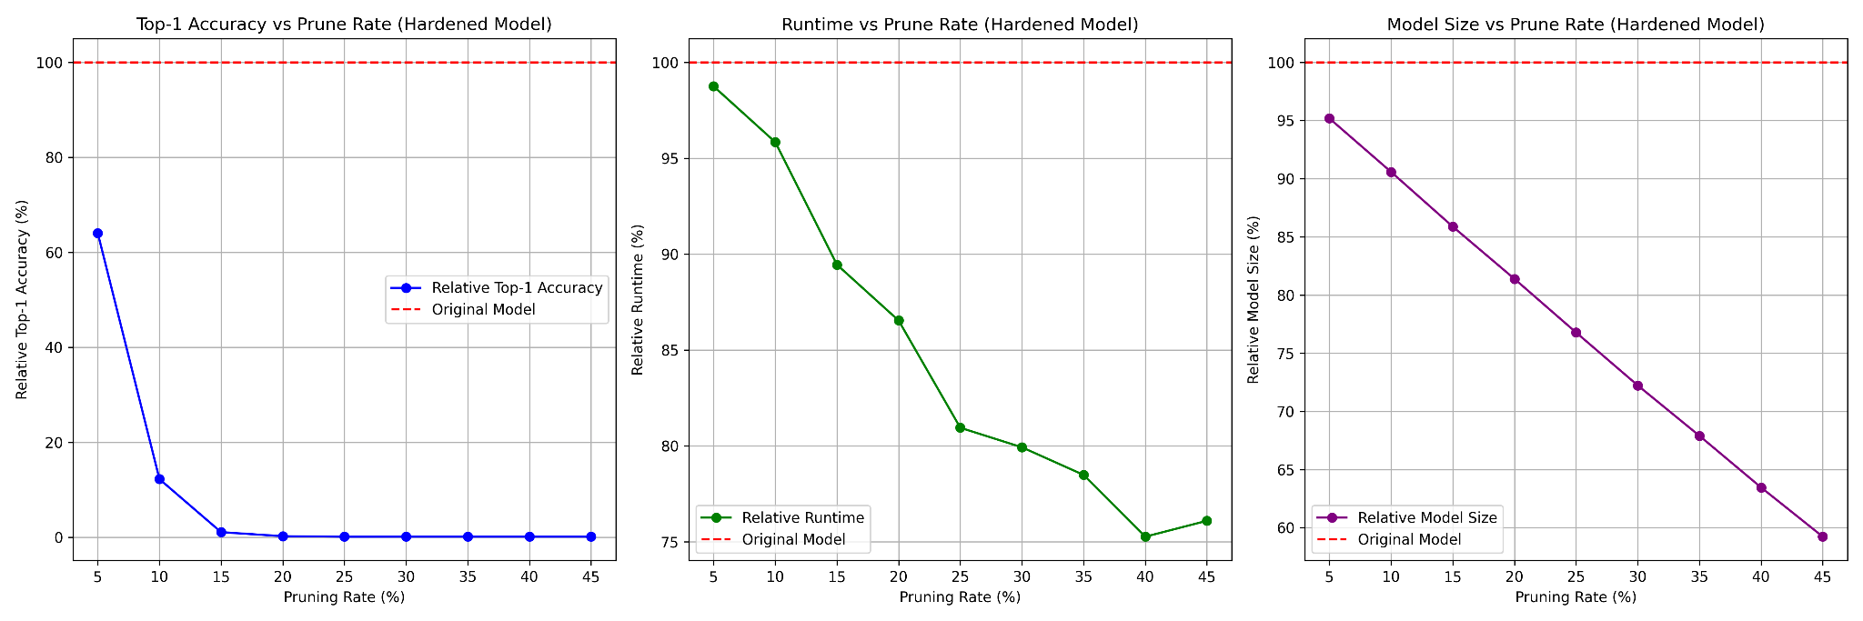
3.5 Layer-wise Channel (Hardened) Pruning
The relative top-1 accuracy drops sharply even at low pruning rates 5%-10% and becomes negligible beyond 15% pruning
This indicates that hardened channel pruning significantly affects the model's ability to retain meaningful features, as entire channels are permanently removed without retraining.
Fig. 4 (a): Plots for evaluating Top-1 Accuracy vs Pruned Amount via Layer-wise Channel Hardened Pruning Method

Slide 13
3.5 Layer-wise Channel (Hardened) Pruning
The relative runtime decreases gradually as pruning increases
At 45% pruning, the runtime reduces to nearly 76% of the original, demonstrating the benefits of structured sparsity.
Fig. 4 (b) : Plots for evaluating Runtime vs Pruned Amount via Layer-wise Channel Hardened Pruning Method

Slide 14
3.5 Layer-wise Channel (Hardened) Pruning
The relative model size decreases linearly with the pruning rate
Reaches less than 60% of the original size at 45% pruning.
Fig. 4 (c): Plots for evaluating Model size vs Pruned Amount via Layer-wise Channel Hardened Pruning Method
Notes:
This reflects the direct removal of pruned channels, which reduces storage requirements effectively.

Slide 15
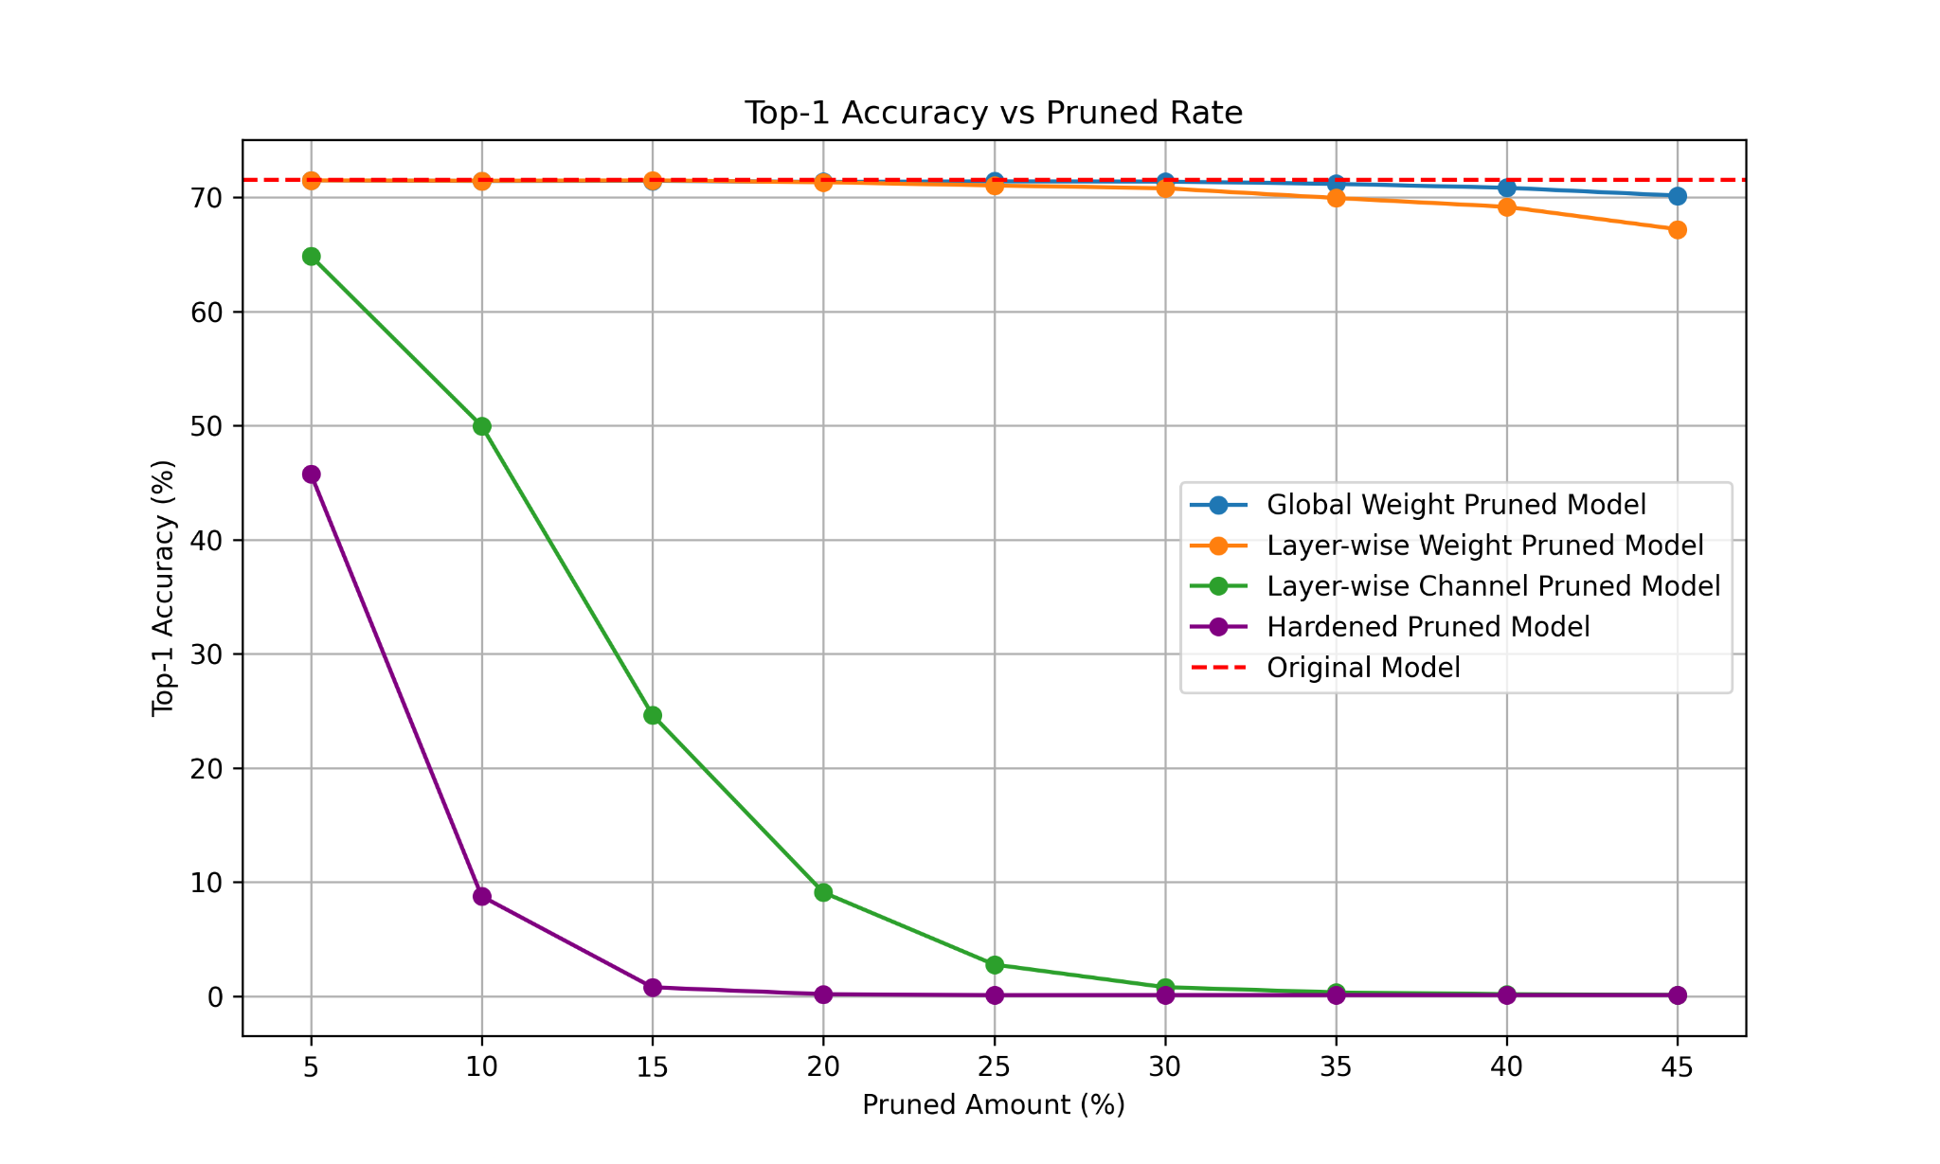
Comparisons of all the Pruning Methods
Fig. 5: Plots for comparing Top-1 Accuracy of all the pruning methods
Notes:
This reflects the direct removal of pruned channels, which reduces storage requirements effectively.

Slide 16
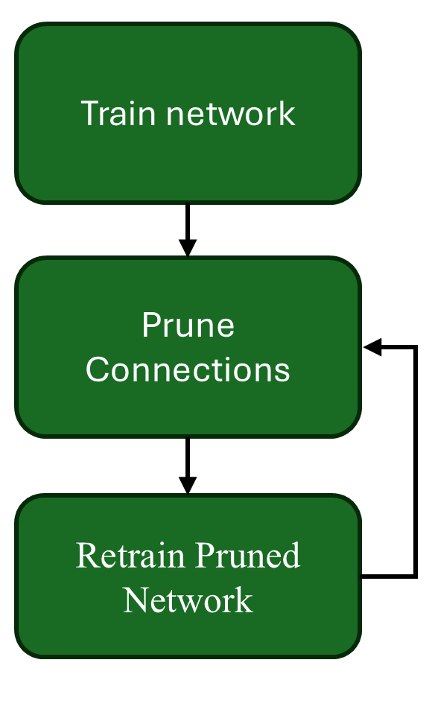
4. Iterative Pruning
Algorithm
Initialize the model.
Train the model.
Prune x% of weights with the smallest magnitude.
Repeat until desired sparsity/accuracy is met.
Fig. 6: Three Stage Iterative Pruning Pipeline

Slide 17
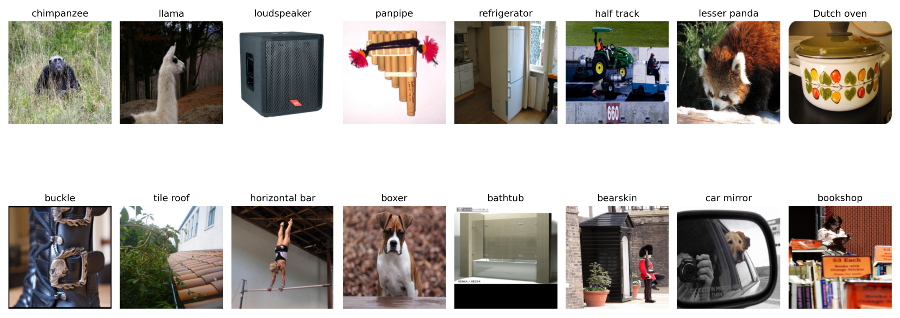
4. Dataset
Due to lack of computational resources, we only use the validation part of the ImageNet dataset[*]
Consists of 50000 images belonging to 1000 different categories.
We split these 50000 images into training/testing splits in the ratio 90:10.
Fig 7: Samples from ImageNet Dataset
[*] J. Deng, W. Dong, R. Socher, L. -J. Li, Kai Li and Li Fei-Fei, "ImageNet: A large-scale hierarchical image database," 2009 IEEE Conference on Computer Vision and Pattern Recognition, Miami, FL, USA, 2009, pp. 248-255, doi: 10.1109/CVPR.2009.5206848.

Slide 18
4. Experimental Setup
We train the model in Kaggle environment with 16 Gb T4 GPU and 30 Gb CPU RAM.
Optimizer: Stochastic Gradient Descent
Learning Rate: 0.001
Momentum: 0.9
Pruning Method: L1 norm-based Layer Pruning + L1 norm-based Layer Channel Pruning.
Prune Amount every Iteration: 10%
Epochs every Iteration: 7
Prune Amount every Iteration: 25%
Epochs every Iteration: 7
Iterative Layer Channel Pruning
Iterative Layer Pruning
[*]: Muhammad Hasnain Javid. (2022). Melanoma Skin Cancer Dataset of 10000 Images [Data set]. Kaggle. https://doi.org/10.34740/KAGGLE/DSV/3376422

Slide 19
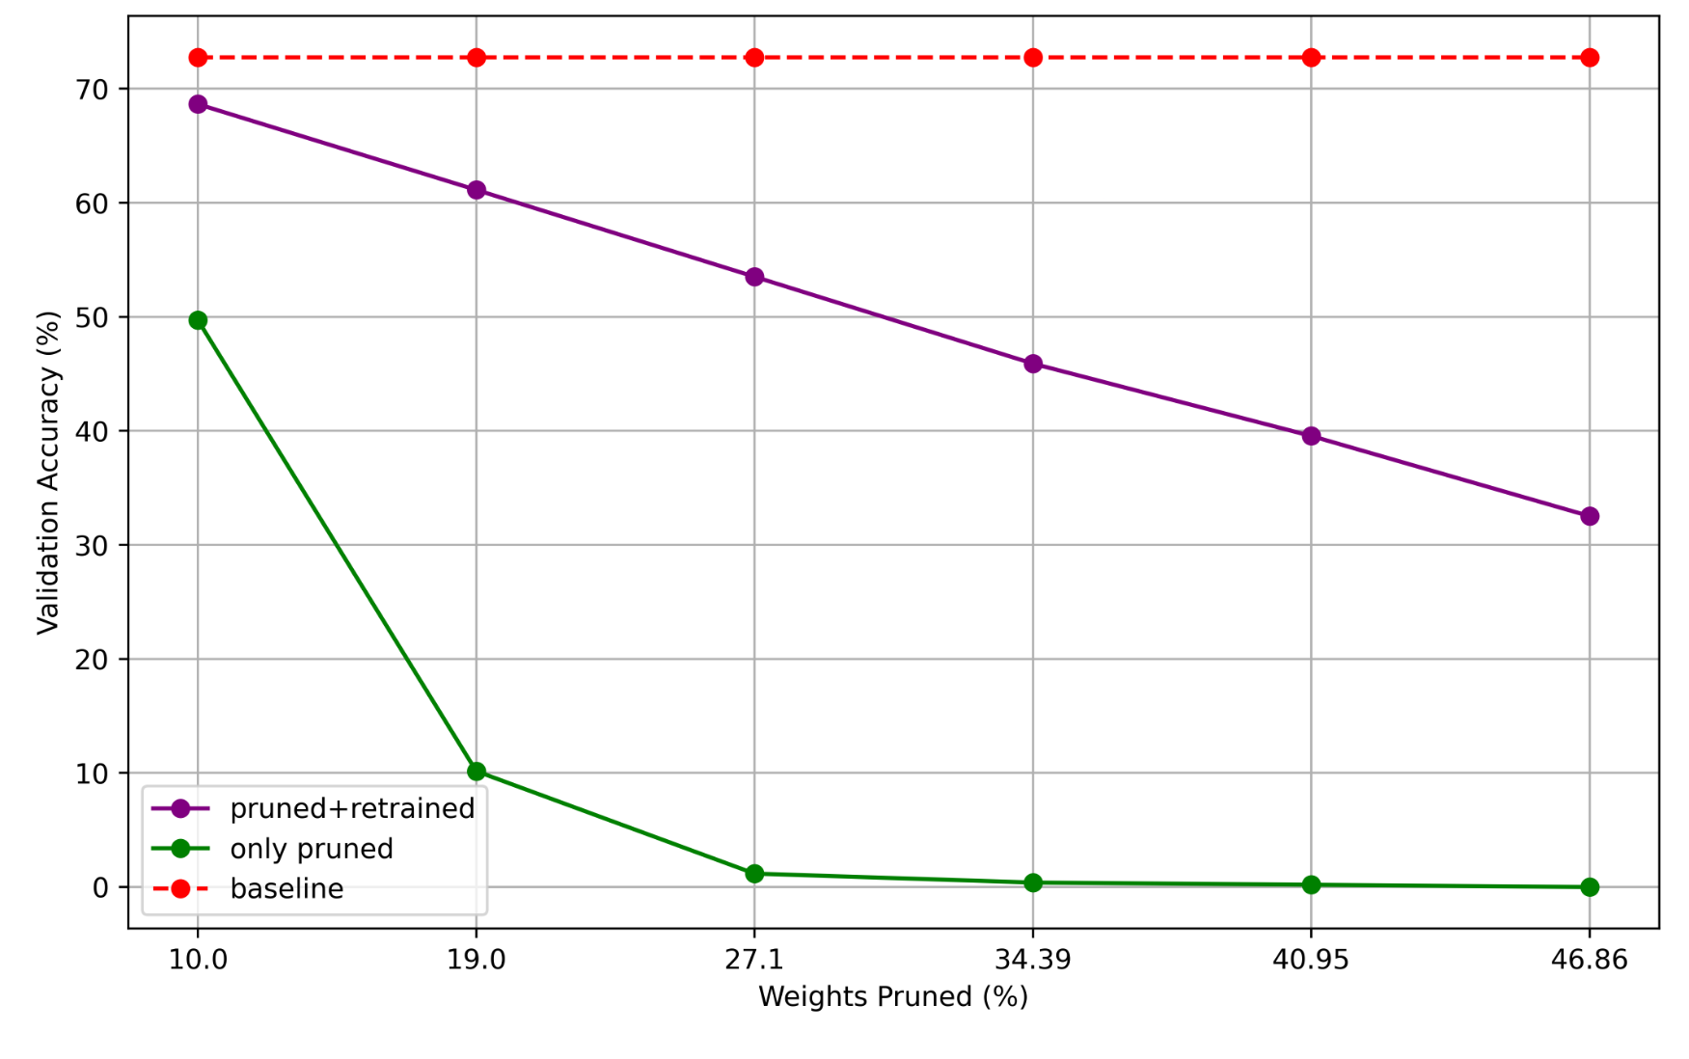
4. Iterative Pruning (Results- Layer Channel)
Model is able to recover a lot of lost accuracy after retraining.
For prune percentage above 10% retraining is absolutely necessary.
Fig. 8: Validation Accuracy vs Number of Pruned Weights (Layer Channel Pruning)

Slide 20
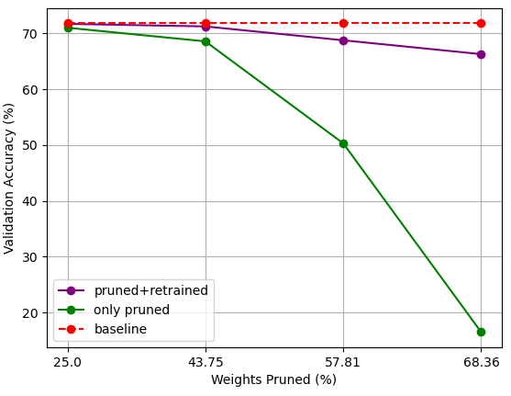
4. Iterative Pruning (Results - Layer Wise)
We see that the the model is able to recover accuracy after each iteration till almost 70% weights are pruned.
We use ≈3.3x lesser weights while preserving the accuracy.
Fig. 9: Validation Accuracy vs Number of Pruned Weighs (Layer Pruning)
Notes:
Ill skip this part

Slide 21
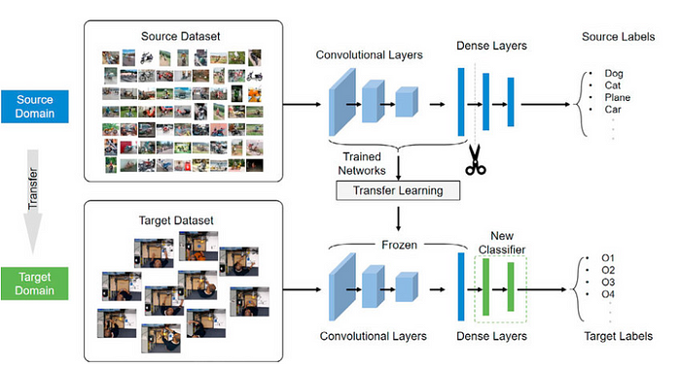
5. Transfer learning
To extend our work, we wanted to explore the possible application of Iterative Pruning in Transfer Learning.
Transfer learning is a technique where a model developed for a specific task is adapted for a different but related task.
Instead of training a new model from scratch, transfer learning leverages the knowledge encoded in a pretrained model, allowing it to generalize to new tasks with fewer resources.
Fig. 10: Transfer Learning Paradigm [*]
[*]: https://www.tredence.com/blog/transfer-learning-and-data-augmentation-in-deep-learning

Slide 22
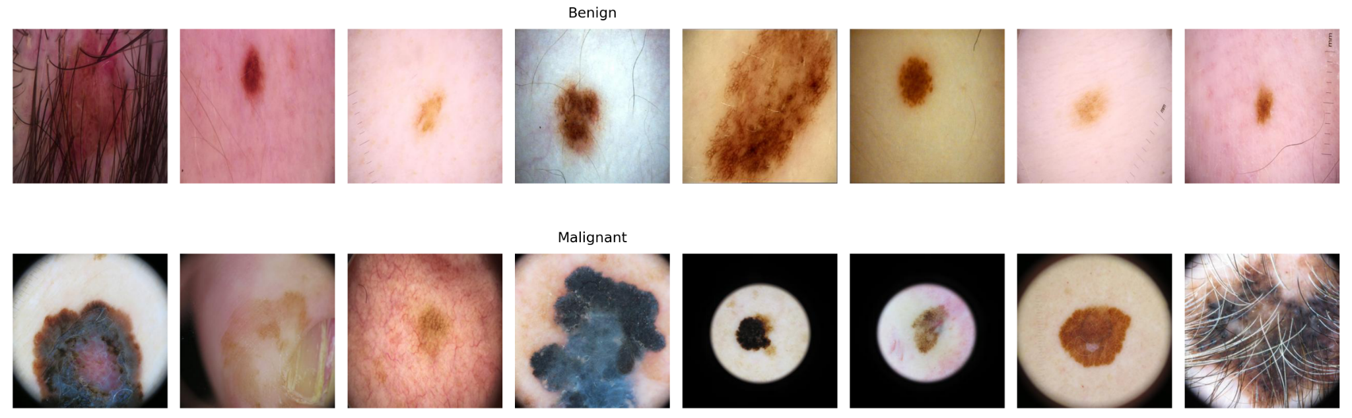
5. Dataset
We choose open source Melanoma Cancer dataset[*] for our transfer learning process.
There are a total of 10605 images belonging to two classes.
We use 9605 images for training and 1000 images for testing purpose.
Category | # Images for Training | # Images for Testing
Benign | 5000 | 500
Malignant | 4605 | 500
Fig 11: Samples from Melanoma Cancer Dataset
[*]: Muhammad Hasnain Javid. (2022). Melanoma Skin Cancer Dataset of 10000 Images [Data set]. Kaggle. https://doi.org/10.34740/KAGGLE/DSV/3376422

Slide 23
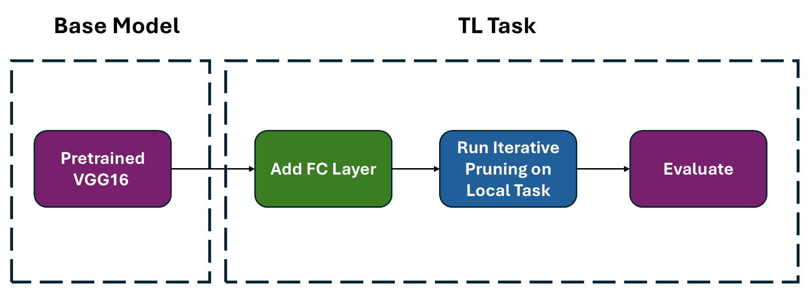
5. Setup 1
Need to do iterative pruning on each local task.
Hence not Transfer Learning friendly.

Slide 24
5. Experimental Setup
We train the model in Kaggle environment with 16 Gb T4 GPU and 30 Gb CPU RAM.
Optimizer: Stochastic Gradient Descent SGD
Learning Rate: 0.001
Momentum: 0.9
Pruning Method: L1 norm-based Layer-wise Pruning
Prune Amount: 10%
Epochs Retrained: 10
[*]: Muhammad Hasnain Javid. (2022). Melanoma Skin Cancer Dataset of 10000 Images [Data set]. Kaggle. https://doi.org/10.34740/KAGGLE/DSV/3376422

Slide 25
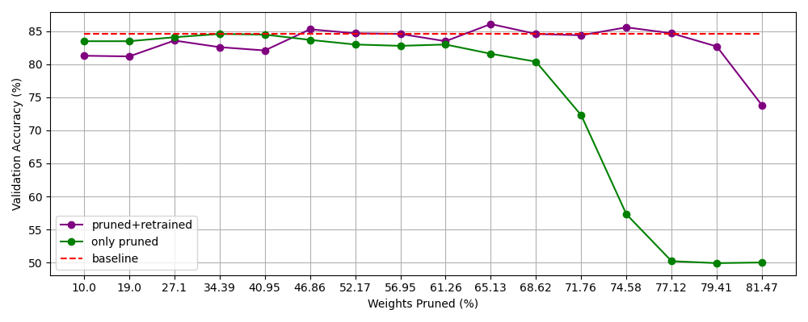
5. Setup 1 (Results)
We see that the the model is able to recover accuracy, after each iteration, till almost 80% weights are pruned.
We use ≈5x lesser weights while preserving the accuracy.
Fig. 12: Validation Accuracy vs Number of Pruned Weighs of VGG16 on Melanoma Cancer Dataset
Notes:
Heavily over parameterized. First 68 percent weights are useless. no retraining needed

Slide 26
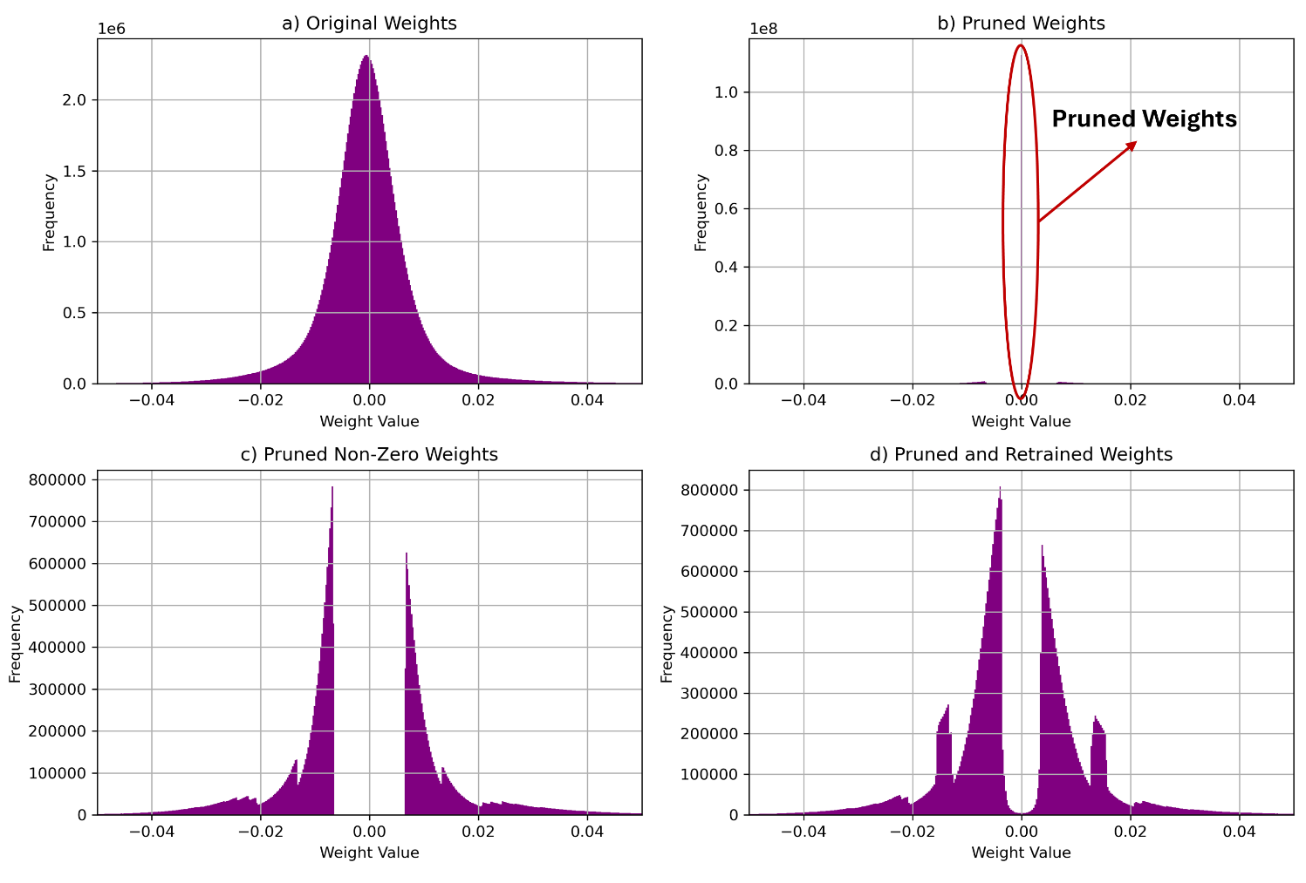
5. Setup 1 (Results)
All Layers
After pruning the large center region is removed corresponding to 80% of the weights.
The network parameters adjust themselves during the retraining phase.
Fig. 13: Weight Distribution of (a) Original VGG16 model (b) Pruned VGG16 (c) Non-Zero Weights of Pruned VGG16 (d) Pruned and Retrained VGG16

Slide 27
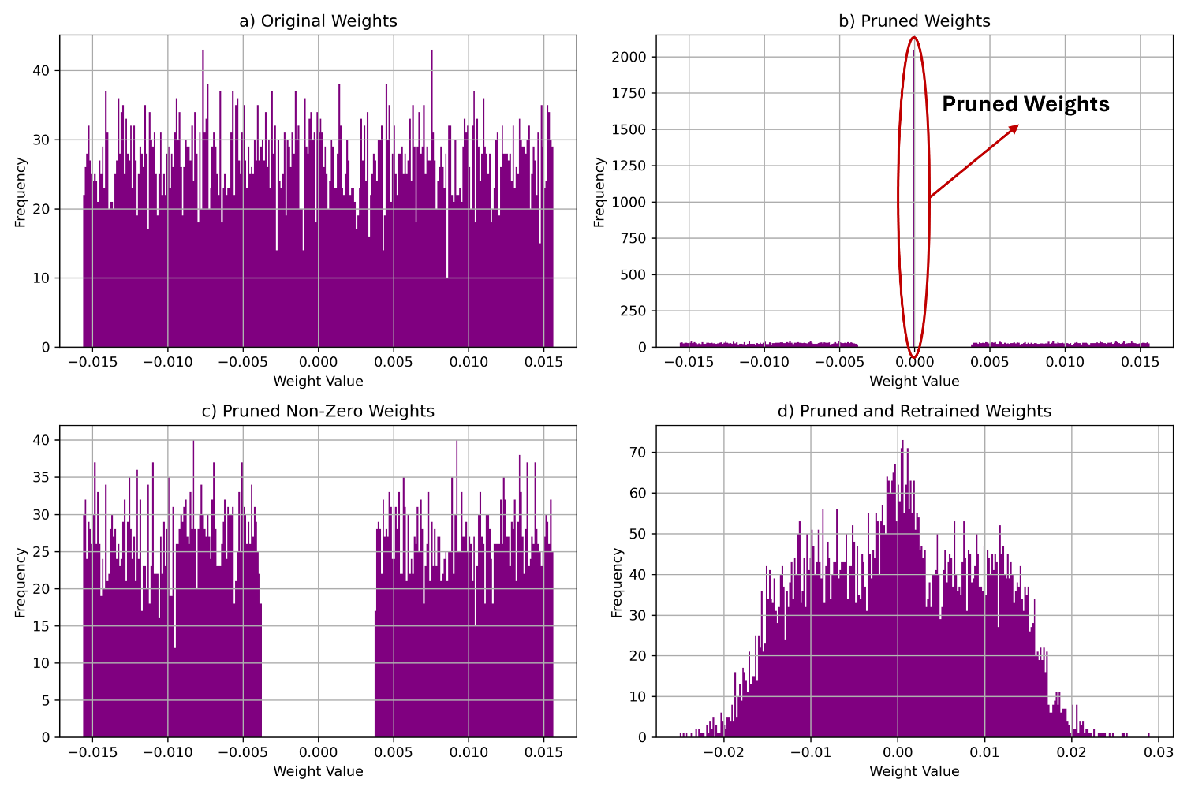
5. Setup 1 (Results)
Last Fully Connected Layer
After pruning the large center region is removed corresponding to 80% of the weights.
The network parameters adjust themselves during the retraining phase, which is clearly visible.
Fig. 14: Weight Distribution of Last Layer of, (a) Original VGG16 model (b) Pruned VGG16 (c) Non-Zero Weights of Pruned VGG16 (d) Pruned and Retrained VGG16, on Cancer Dataset

Slide 28
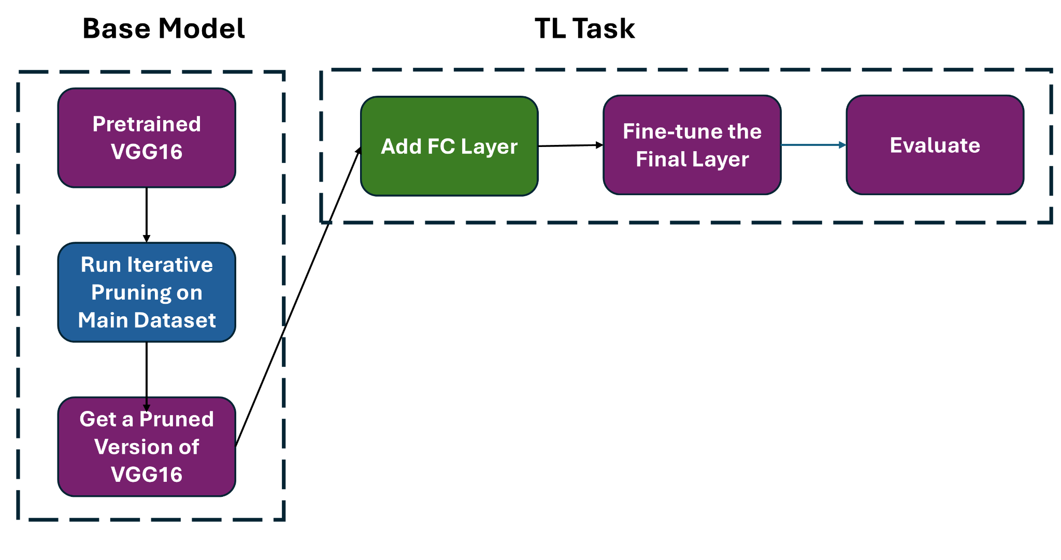
5. Setup 2
Need to do iterative pruning only one at the baseline.
Transfer Learning friendly.

Slide 29
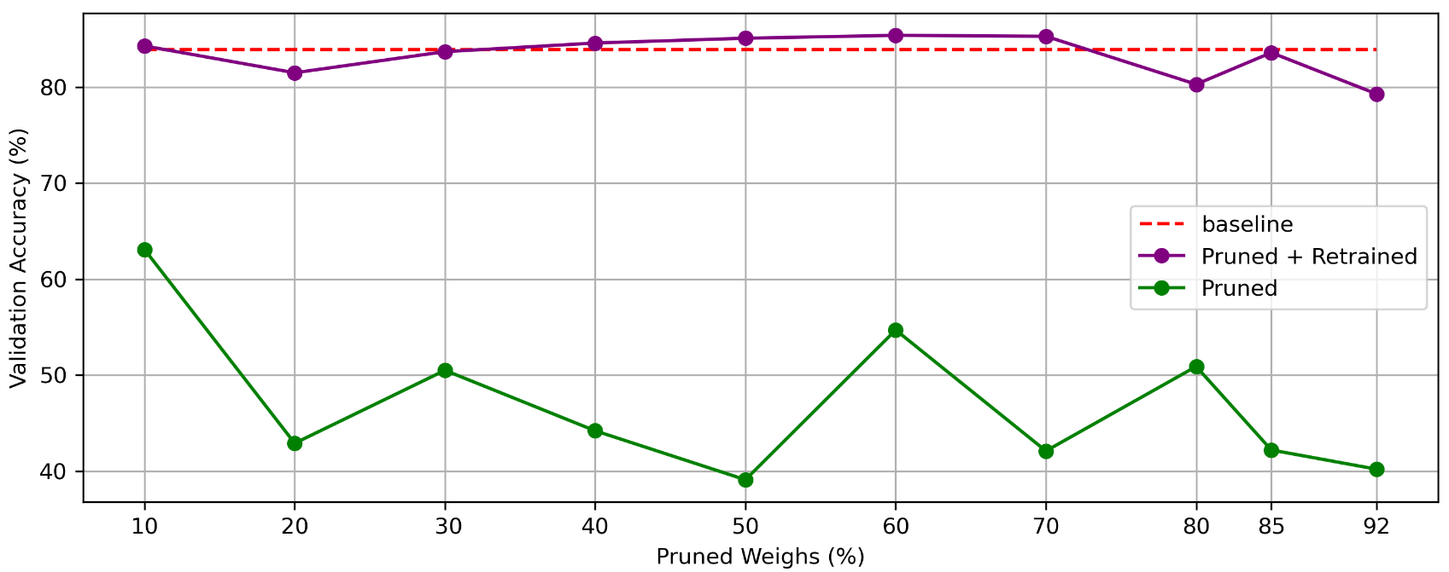
5. Transfer Learning (Results)
In this case the last layer is not pruned hence we can recover almost all lost accuracy after retraining.
Fig. 11: Validation Accuracy vs Number of Pruned Weighs of VGG16 on Melanoma Cancer Dataset

Slide 30
Conclusions
Using a pretrained VGG16 model on the ImageNet validation dataset, we analyze global pruning, layer-wise unstructured pruning, layer-wise channel pruning, and hardened channel pruning.
Further investigated iterative pruning, where pruning and fine-tuning are repeated across multiple cycles to maximize sparsity while recovering lost accuracy.
Additionally, we extended the analysis to transfer learning by fine-tuning pruned models on the melanoma cancer dataset. This demonstrates the adaptability models to new tasks with iterative pruning, assessing their potential for real-world applications in computationally constrained settings.

Slide 31
Thank You!

Slide 32
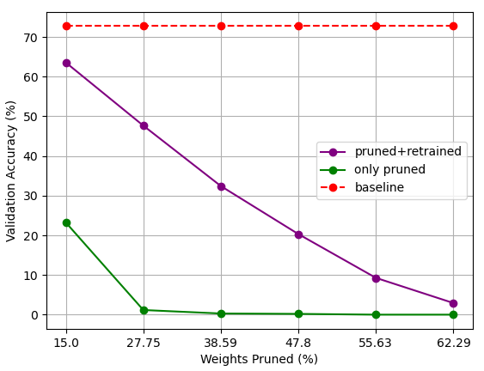
4. Iterative Pruning (Results) (Extra)
Model is able to recover a lot of lost accuracy after retraining.
For prune percentage above 15% retraining is absolutely necessary.
Fig. 7: Validation Accuracy vs Number of Pruned Weights (Layer Channel Pruning)

